Slide 1
Lesson 5 Chapters 9-10
Streams/files
Command-line arguments
Dates and time
Method overloading (not overriding)
Keyboard input
Access levels

Slide 2
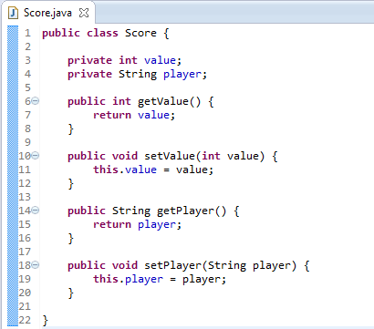
FileOutputStream
Notes:
Imagine that we have a class named ‘Score’. We want to save the ‘state’ of a score object.
We can see that there is a name of the player, and the score achieved.

Slide 3
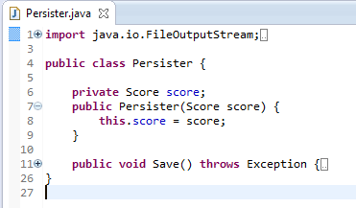
FileOutputStream
Notes:
The class ‘Persister’ takes a ‘Score’ object as argument to the constructor, and saves it to a local attribute.
The save method will save the ‘Score’ object to a file.

Slide 4
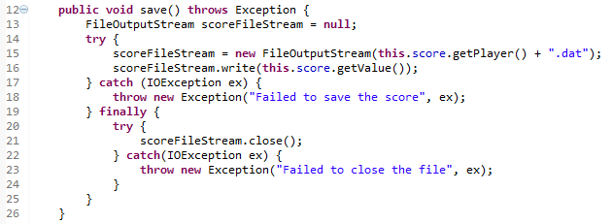
FileOutputStream
Notes:
We create a new FileOutputStream and gives it the name of the file as the argument to the constructor.
The name of the file will be the name of the player.
Then we call the ‘write’ method to put the score into the file.
Notice how we call the ‘close’ method inside the ‘finally’ clause.

Slide 5

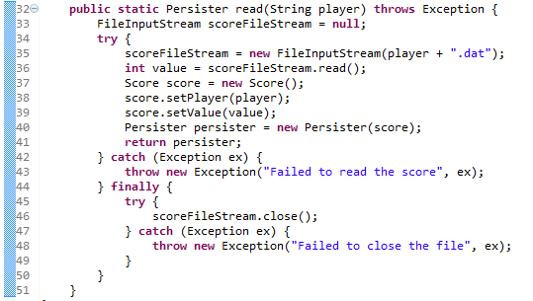
FileInputStream
Notes:
We will read the value back in the ‘read’ method.
If we had come to the end of the file, the ‘read’ method will return -1.
Since we are making the ‘read’ method static and returning an instance of ‘Persister’, we also need to add a ‘getter’ for the score.

Slide 6
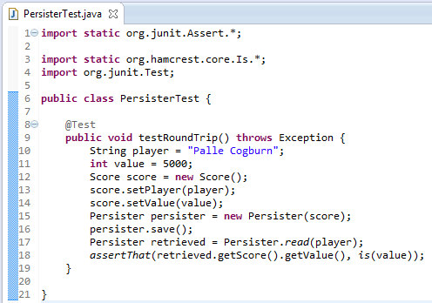
Test
Notes:
Here is our test.
We save the score, read it back, and compare.

Slide 7
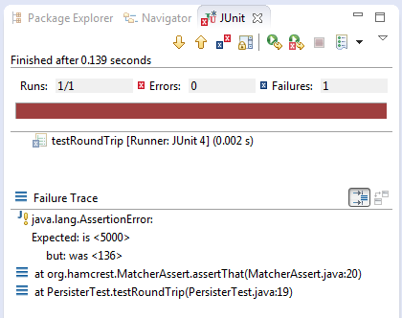
Fail
Notes:
It failed!
Can you see why?
It is because the lowest 8 bits of 5000 dec is 136. So we must write, and read the value byte for byte.
We need to use DataInputStream, and DataOutputStream.

Slide 8
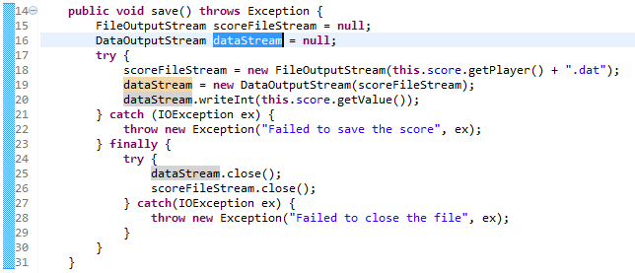
DataOutputStream
Notes:
The ‘DataOutputStream’ constructor can take another ‘OutputStream’ as argument, so we pass in the ‘FileOutputStream’.
Instead of writing directly to the ‘FileOutputStream’, we write to the ‘DataOutputStream’ using the method ‘writeInt’.
We must remember to close the ‘DataOutputStream’ also, and before closing the ‘FileOutputStream’.

Slide 9
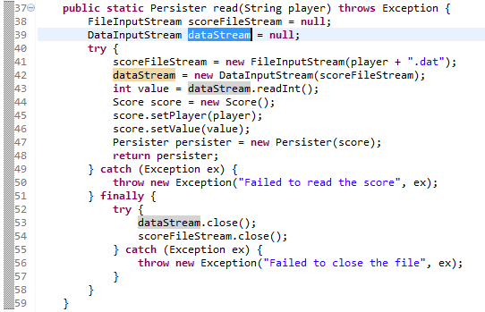
DataInputStream
Notes:
The ‘DataInputStream’ constructor can take another ‘InputStream’ as argument, so we pass in the ‘FileInputStream’.
Instead of reading directly from the ‘FileInputStream’, we read from the ‘DataInputStream’ using the method ‘readInt’.
We must remember to close the ‘DataInputStream’ also, and before closing the ‘FileInputStream’.

Slide 10
Command-line arguments
Usage:
java Persister save "Palle Cogburn" 5000
java Persister read "Palle Cogburn"
Notes:
If we were to run the ‘Persister’ class as an application, we would want to pass in arguments from the command-line.
Here the first argument is either ‘save’, or ‘read’. The second argument is the player’s name.
If it was a save, we also want to specify the score value.

Slide 11
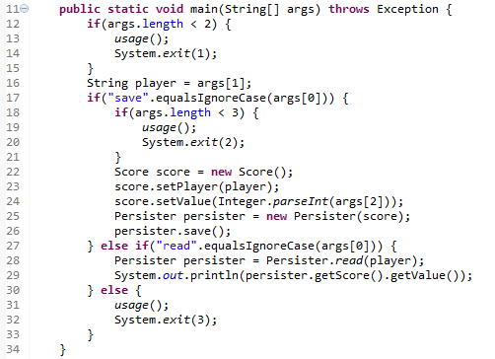
Command-line arguments
Notes:
Let’s add a ‘main’ method to the ‘Persister’ class, so we can run it as an application.
The usage method is a small method that tells the user how to use the application.
The ‘System.exit’ calls are for terminating the application immediately. If you pass an argument other than ‘0’ (zero), it means that the application failed.
It can be checked with the environment variable ERRORLEVEL.

Slide 12
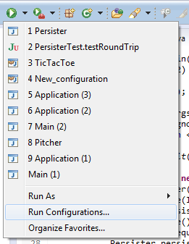
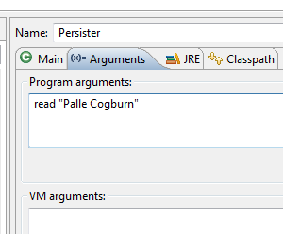
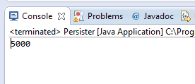
From Eclipse
Notes:
If we choose “Run Configurations…” we can specify the command-line arguments.

Slide 13
Dates and time
Classes that deal with Date, Time, and its format:
java.util.Date
java.text.SimpleDateFormat

Slide 14
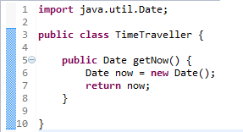
Dates and time
To get the current date and time, you construct a new instance of Date.

Slide 15
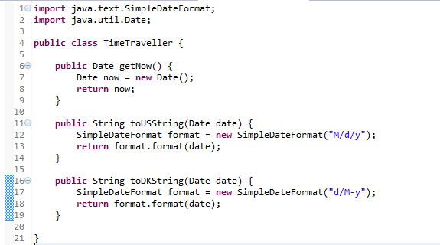
Dates and time
Notes:
Use SimpleDateFormat to convert the date to a String.
The date in Denmark looks different than here in US.

Slide 16
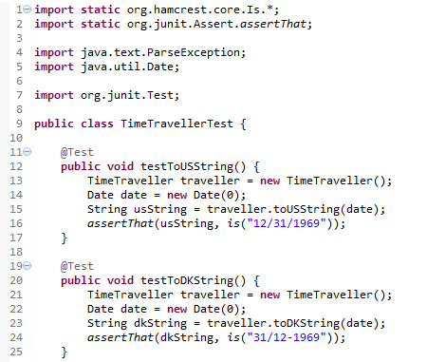
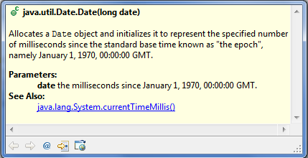
Date and times
Notes:
Of course we need a test.
Different parts of the world use different formats for date.
Notice that the Date object is constructed with a ‘0’ argument. That means 0 milliseconds after epoch. Since it is GMT, and we are PDT (GMT -8), it becomes the day before.

Slide 17

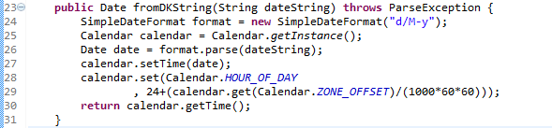
Date and times
Notes:
You can also make a String into a Date using the ‘parse’ method in SimpleDateFormat.
Because of the time zone, we need to set the ‘HOUR_OF_DAY’ correctly to get back to the same value as ‘new Date(0)’.
The Calendar class has convenient methods to do this for us.

Slide 18
Method overloading
A class can have more than one method with the same name.
The arguments must be different.
It can be used for default values.

Slide 19
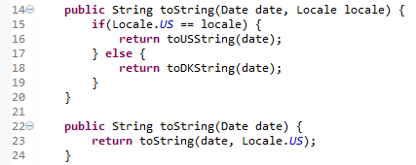
Method overloading
Notes:
In our TimeTraveller class, we could have two overloaded ‘toString’ methods. One that takes two arguments; Date, and Locale, and one that only takes Date. One method will then delegate to the other method passing the default parameter.

Slide 20
Keyboard input
The System.out variable is a java.io.OutputStream.
The System.in variable is a java.io.InputStream
The java.io.InputStreamReader changes the input from bytes to characters
A java.io.BufferedReader reads one line at a time.

Slide 21
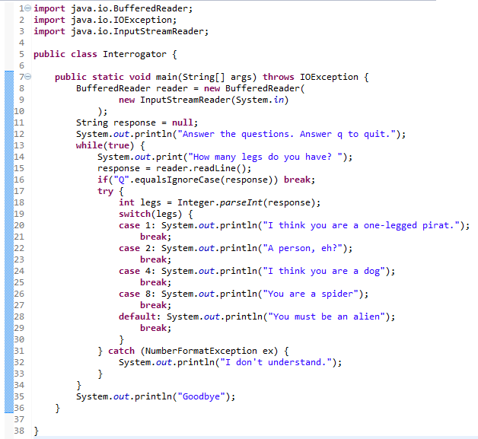
Keyboard input
Notes:
This program will create a BufferedReader.
It then prints to the standard output “Answer the questions. Answer q to quit.”
Then there is an infinite loop where it asks “How many legs do you have?” If you answer a number, it will give a guess at who you are.
If you answer something other than a number, it will say “I don’t understand.”
Finally it will print out “Goodbye” if you answer with a ‘q’.

Slide 22
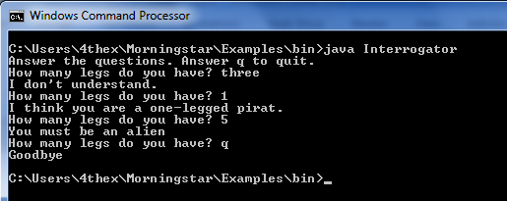
Keyboard input

Slide 23
Access levels
Can be assigned to:
Classes
Methods
Attributes

Slide 24
Access levels
private
Access only from inside the class itself
default
Access only from inside the package
protected
Access from the package or inherited classes regardless of package
public
Access from anywhere

Slide 25
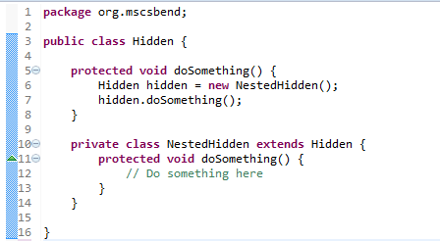
Access levels
Notes:
The class Hidden has a nested class called NestedHidden that is private.
It extends from Hidden, so we can assign it to a local variable of type Hidden.
When we call the ‘doSomething’ method, it really calls the one in ‘NestedHidden’.

Slide 26
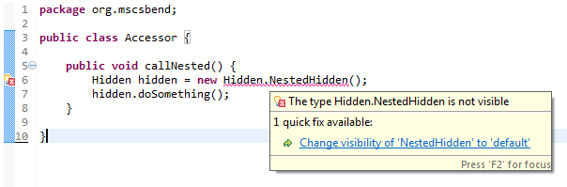
Access levels
Notes:
If we try to construct ‘NestedHidden’ from another class, the compiler complains. Eclipse suggests to change the visibility of ‘NestedHidden’ to default.

Slide 27
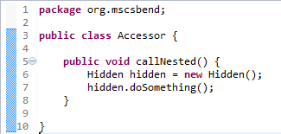
Access levels
Notes:
Instead we can just call ‘doSomething’ on ‘Hidden’ because it in turn calls the method in ‘NestedHidden’.
We say that ‘Hidden’ provides access to ‘NestedHidden’. We can also say that ‘Hidden’ is a ‘NestedHidden’ proxy.

